Slide 1
Article Management
Group Number 3

Slide 2
Agenda
Introduction
System Functionality
User Guide
Demonstration
Questions and Answers

Slide 3
What is
Article Management?

Slide 4
Article management system
A user account management system is a comprehensive way to enable users to manage their profiles and do things efficiently. The system supports seamless communication between users and administrators, and provides a structured framework for content creation, display, and consumption.

Slide 5
System Functionality

Slide 6
Functionalities
Login and Logout:
Secure login with email and password.
Password recovery options, including email verification and security questions.
Sign Up:
Simplified registration process with mandatory email verification.
User Can Post:
Users can create new articles, save drafts, and submit for review.
Article templates for consistent formatting and style.
Article Management
Dashboard:
Centralized dashboard for users to manage their articles.
Filters and search options to quickly locate specific articles.

Slide 7

User Guildline
Please check the screenshot below

Slide 8
NAVIGATING Q&A SESSIONS
Know your material in advance
Anticipate common questions
Rehearse your responses
Maintaining composure during the Q&A session is essential for projecting confidence and authority. Consider the following tips for staying composed:
Stay calm
Actively listen
Pause and reflect
Maintain eye contact

Slide 9
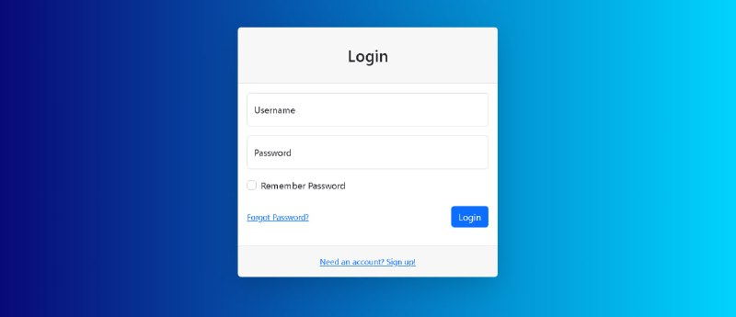
Login form
Login form really simple and login by using Username and password for authorize

Slide 10
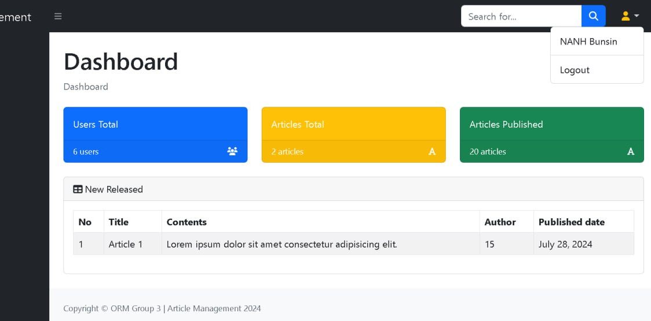
Dashboard

Slide 11
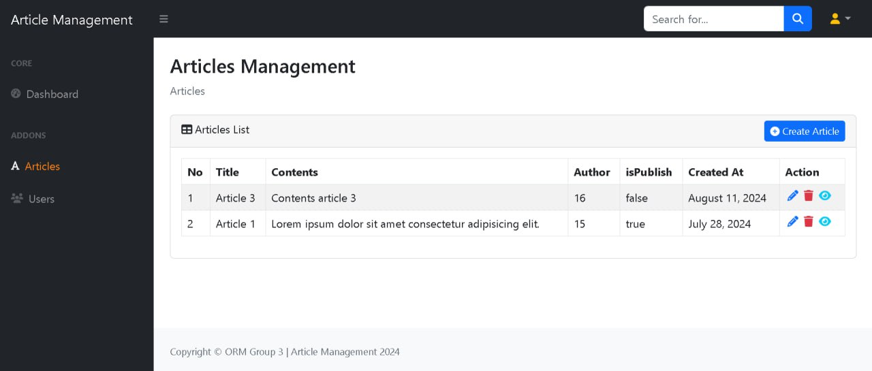
Articles management
User can:
Add
Edit
Delete
View

Slide 12

Conclusion
The User Article Management System provides a user-friendly environment for managing user profiles and creating content. With secure authentication, user management, and article creation capabilities, it supports collaboration and interaction between users, editors, and administrators, fostering a dynamic platform for content sharing and engagement.

Slide 13
THANK YOU
Group 3
Lyhor Ngorn
Bunsin Nanh
ChhayLaing

